Slide 1

Project Review presentation on
“ Predicting next word in a sentence using Recurrent Neural Network “
Presented By
Group ID – B8
Mr. Zaid Shaikh (4251)
Mr .MohammadAyaan Pathan (4221)
Mr .MuaazKhan Pathan (4222)
Mr. Avinash Waghmare (4275)
Project Guide
Prof. A.N.Nawathe
AMRUTVAHINI COLLEGE OF ENGINEERING,SANGAMNER
DEPARTMENT OF COMPUTER ENGINEERING
2022-2023

Slide 2
Contents
Problem Statement
Motivation
Objective
Literarure Survey
Feasibility
Scope

Slide 3
Problem Statement
Develop a graphical user interface based text prediction system, which suggests text based on the previous typed text by the user through recurrent neural network , Long Short Term Memory & BERT (Bidirectional Encoder Representations from Transformer) method.

Slide 4
Motivation
There is an ever increasing number of users using search engines as primary source of knowledge & information.
This generate and store a wealth of data that is mostly private but can be utilized to develop models which can prove to be much more accurate in making predictions about the users behavior & optimize their search .
This has been one of the key motivation for this project which is focused on implementing next word prediction using BERT model.

Slide 5
Objectives
This application is focused on reducing human efforts by suggesting the next word based on previous text.
Word prediction model will improve writing fluency for students whose typing is slow and laborious, and also has the potential to increase accuracy by decreasing spelling and keyboarding errors.
Studied RNN, LSTM, BERT and GPT-2 algorithm which will predict the relevant words for user.
Implemented BERT algorithm because it gives high performance on small datasets for a large range of tasks.

Slide 6
Scope of the Project
The text prediction model based on Recurrent Neural Network system is highly essential for all individual in modern technology platforms
This system is further enhanced with benefitable features for upgrading in future. The methodology of enhancement in the automatic prediction of text are done by BERT Algorithm.
Text prediction has wide scope in many software platforms such as mobile applications, computer softwares, websites etc.

Slide 7
Feasibility
The proposed model is highly reliable and can be used in our day today life.
Our model is trained on paragraph & but in real life we can implement in on large scale.
For large scale implementation we will use user’s search history.

Slide 8
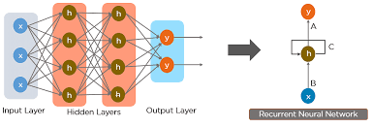
Literature Survey
Title: Recurrent Neural Network based Models for Word Prediction
Author: S.Ramya, C.S.Kaniozhi Selvi
Publication : IJRTE
Year: 2019
Presented Recurrent Neural Network model.
When neurons are connected it is known as RNN. RNN is basically used for understanding & analyzing text.
But this model is hard to train & was not good at handling large sequence of text(paragraph) so other techniques were introduced

Slide 9
Title : Predicting next Word using RNN and LSTM cells: Stastical Language Modeling
Author: Aejaz Farooq Ganai, Farida Khursheed
Publication: IEEE
Year: 2019
- In this paper author has proposed LSTM technique.
- LSTM is special kind of RNN capable of learning long term dependencies specially in sequence predition problem.
- Eg 1 : The clouds are in the sky (RNN Example)
- Eg 2 : I grew up in France ……. I speak fluent French (LSTM Technique)

Slide 10
Title: A Text Generation and Prediction System: Pre-training on New Corpora Using BERT and GPT-2
Author: Yuanbin Qu, Lizhen Liu, Miaomiao Cheng
Publication: IEEE
Year: 2021
- Author proposed deep neural network model based on Transformer family.
The transformer is a component used in many neural network designs for processing sequential data, such as text data
- Transformer were introduced for translation by Google is 2017.
BERT is a transformer-based language model that learns the underlying representation from unlabeled text by jointly processing on both left & right context for learning.
It has 3 parts : Positional Encoding , Attention , Self-Attention(fundamental ope)
BERT is used to generate long sentences ,articles & performs analysis.
GPT is a transformer-based auto-regressive language model, which is pre-trained in a generative, and unsupervised manner. It is trained on tons of unlabeled text
- The model will learn to estimate the probability of any given word sequence, even the one’s it has never seen before.

Slide 11
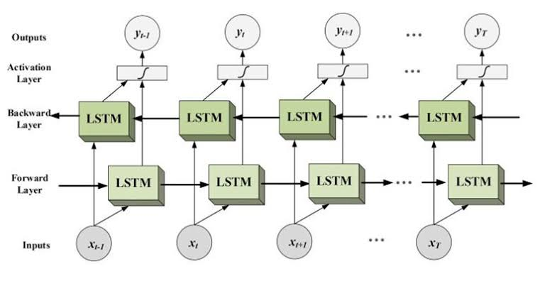
Title: Next Word Prediction in Hindi Using Deep Learning Technique Bi-LSTM
Author: Radhika Sharma, Nishtha Gael , Nishita Aggarwal
Publication: IEEE
Year: 2019
This study proposes a novel methodology to predict the next word in a Hindi sentence.
Two deep learning techniques namely Long
Short Term Memory (LSTM) and Bi-LSTM
have been explored for the task of
predicting next word

Slide 12
Thank You!

